Slide 1
Technifying Education
One-Stop Integrated Solution for all the schools

Slide 2
About Us
SKOLARO is based out of California and is a One-Stop Integrated Solution for all software needs for Schools and School Chains.
It is an Ultimate Integrated Solution for all software needs for
Schools. Skolaro provides a collaborative platform to schools, colleges and vocational institutes to administer educational institutions and, sharing knowledge between students and
educators across the world.

Slide 3
Key Operational Areas
Automate Processes with All in One
Integrated Institute Management System
Administrative
Academics
Financial
LMS
Communicative

Slide 4
Key Operational Areas
Institute
Student
Admissions
Staff
Library
Transport
Inventory
Hostel
Assessment
Attendance
Assignment
Alumni
Automate Processes with All in One
Integrated Institute Management System
Administrative
Academics
Accounting
Payroll
Fee
Financial

Slide 5
Key Operational Areas
Collaboration
Quiz & Question Banks
Student, Parent & Teacher Portal
Automate Processes with All in One
Integrated Institute Management System
LMS
Communicative
Mobile App
Event, SMS & Alerts

Slide 6
50+ Applications
Providing 50+ Applications catering all the needs of an organization.
For CEO/Trustee
For Administrators
For Principal
For Teachers
For Parents
For Students

Slide 7
50+ Applications
Providing 50+ Applications catering all the needs of an organization.
Budget & Forecasting
Dashboards & Reports
Administrative
Academic
Registration & Admissions
Accounting & Finance
Staff & Student Attendance
Curriculum Management
Student Records
Curriculum Management
CCE
Grade Book
Attendance
Quizzes, Question Banks
Document Management
Timetables
Class Groups
Report Cards
Principal
Teachers

Slide 8
50+ Applications
Providing 50+ Applications catering all the needs of an organization.
Budget & Forecasting
Dashboards & Reports
Admissions
Fee Collection
Expenditures
Student Records
Fee Management
Budget & Forecasting
Accounting & Finance
HR Management
Payroll Management
Leave Management
Inventory Management
Registration & Admission
Transportation Management
Library Management
Report Cards
Institute Management
SMS Integration
Direct Messaging
Alumni Management
Parent Groups
School Circulars
CEO, TRUSTEE
ADMINISTRATORS

Slide 9
50+ Applications
Providing 50+ Applications catering all the needs of an organization.
Parent Groups
School Circulars
Children Homework
School SMS
Progress Reports
Fee Payment
Student Certificates
Home work
Class Groups
Questions, Answers
Progress Reports
School Alumni
Folders
Parents
Students

Slide 10
Why should you choose Skolaro?
Skolaro is a complete Integrated Solution which means
One Stop Solution
Detailed and Quick Analytics
Reduce Cost
Single Sign On
No 3rd party integration required
Easy to use
Easy Access to all data
Makes deriving reports easy
Easy to create a personalized dashboard
Data migration done one time
No large IT team required
No dealing with multiple vendors

Slide 11
Aggressive Adoption
7+ Countries
Skolaro is a single platform with
50+ Applications
trusted world-wide
1 million profiles
23000+ organizations

Slide 12
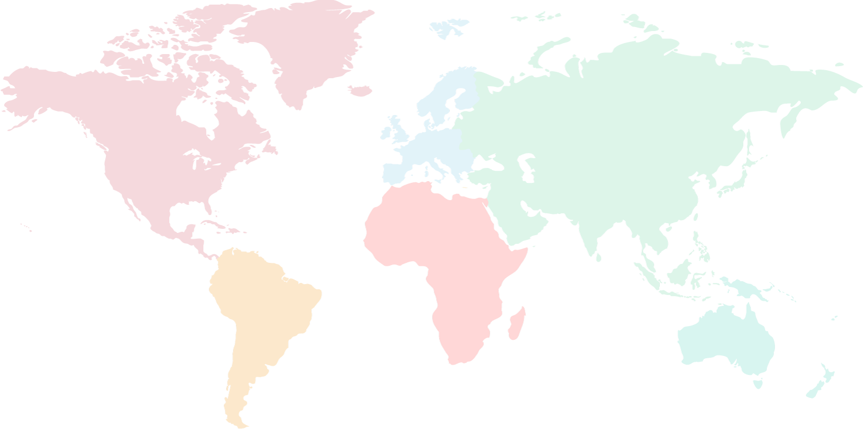
Few Notable Clients
Shiv Nadar School
(5 Branches)
Aditya Birla School
Millennium School
(27 Branches)
Rainbow International School
(8 Branches)
Utpal Shanghvi Global School
YPS School
Guru Harkishan Public School
(10 Branches)
Greenwood High School
Jain International School

Slide 13
Few Notable Clients
Lexicon International School
Nahar International School
Paul George Global School
Angels Paradise School
Pinnacle School
Delhi Public School
St. Andrews School
Indus International School
Indus World School

Slide 14
Few Notable Clients (International)
Al-Manahil-Private-School,-Al-Ain,-UAE
Delhi-Private-School,-Ras-Al-Khaimah,-UAE
A'soud-Global-School--Muscat,-Oman
The-Indian-School,-Ras-Al-Khaimah,-UAE
Hay-Al-Sharooq-International-School,-Sur,-Oman
Horizons-Kids-Nursery---Muscat,-Oman

Slide 15
Centralised Integrated View (Chain Schools)
School 1
School 2
Centralized data for all schools on cloud
CEO, Trustee
School 3
The management gets the instant reports of all the schools related to academics and administration.
Real time data mining, updating & comparison helps the management to make future strategies for their organization.

Slide 16
For Group of Institutions
Hierarchy Based Information
Head Office
Schools
Nursery
School 1
Nursery 1
School 2
Nursery 2

Slide 17
Statistics & Analytics Dashboards
Fee related reports like – Fee defaulters (monthly)
Student related reports like - Daily attendance

Slide 18
Statistics & Analytics Dashboards
Lead related reports like – Leads By Source
Lead related reports like – Lead Conversion By Source

Slide 19
Save with Skolaro
Get all digital reports and save your costing on paper and promote Green Environment with us.
“Go Green, Go Paperless”
With Skolaro Cloud Management System

Slide 20
Thank You
naini@skolaro.com
info@skolaro.com
www.skolaro.com

